Slide 1
Muzix Application
Presented By:
NIKHIL SHRIVASTAVA,
MOHAMMAD KAMRAN,
RAGHUNATH M

Slide 2
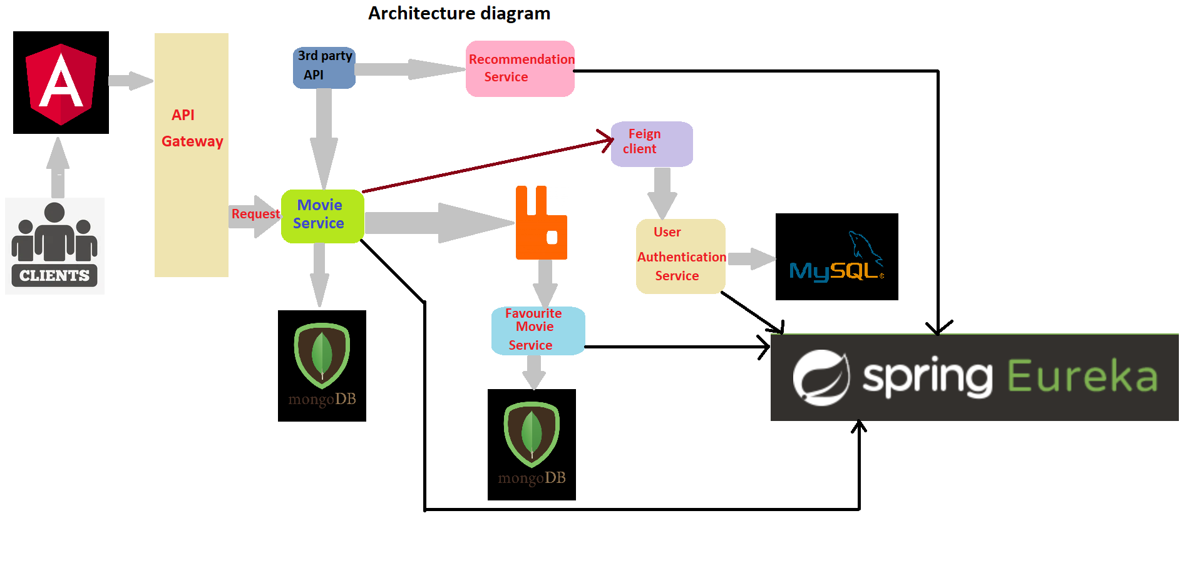

Slide 3
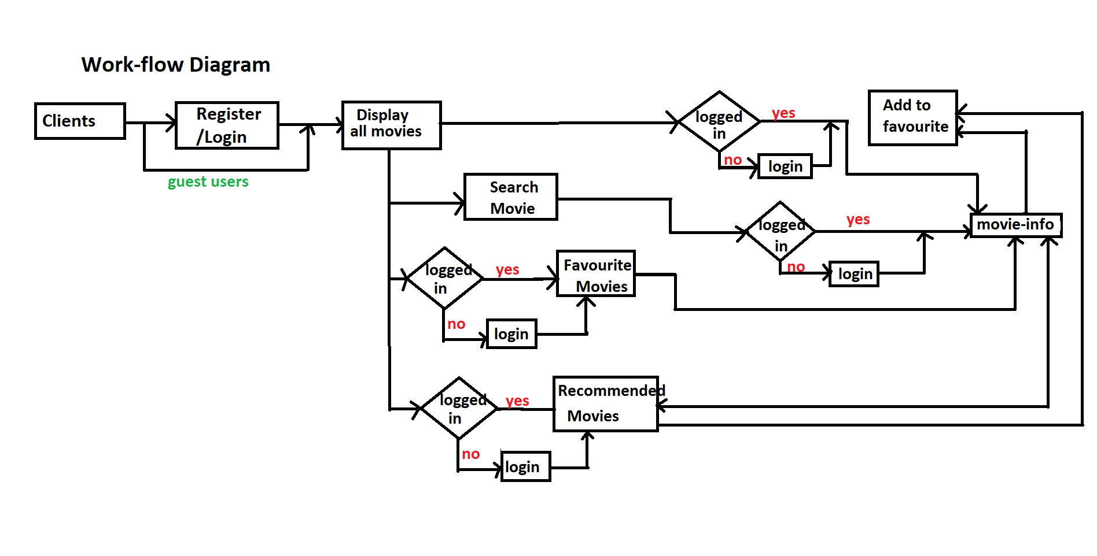

Slide 4
Tools & technology
BackEnd
Spring boot
Eureka Server
API Gateway
Feign Client
RabbitMQ
Docker
FrontEnd
Angular
Databases
MongoDb
MySQL

